Slide 1
CAPSTONE PROJECT REPORT
SIMULATION OF CONTROL RULE OF ELECTRIC POWER STEERING SYSTEM
Instructors: Dr. NGO DAC VIET
DR. TRAN DANG LONG
STUDENT: DANG MINH DUY - 1910933

Slide 2
TABLE OF CONTENTS
INTRODUCTION
THEORETICAL BASIS
SIMULATION PROCESS
RESULTS AND EVALUATION
FUTURE WORK AND ENHANCEMENT

Slide 3
1. INTRODUCTION
Type: Scientific research
Objective: Determine and simulate the control of the assisting motor and control rules of EPS according to different vehicle speeds and steering wheel angles.
Technical requirements:
Simulation model works properly
Accurate assisting moment
Assisting moment from motor can follow as desired
Vehicle moves as desired

Slide 4
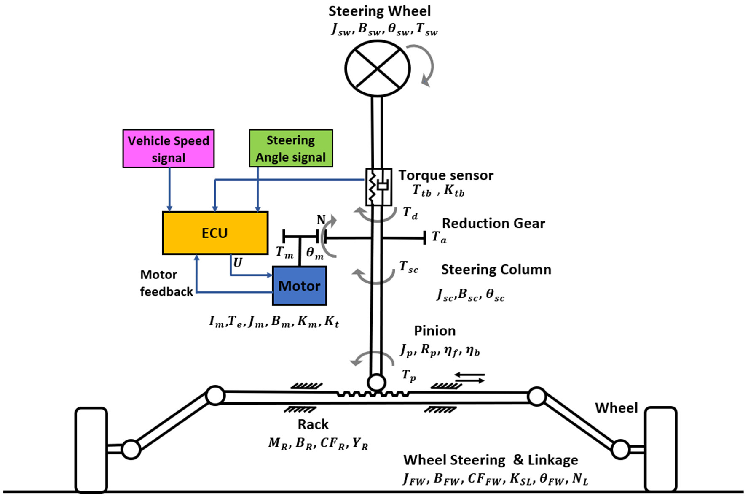
2. THEORETICAL BASIS 2.1. ELECTRIC POWER STEERING (EPS) SYSTEM

Slide 5
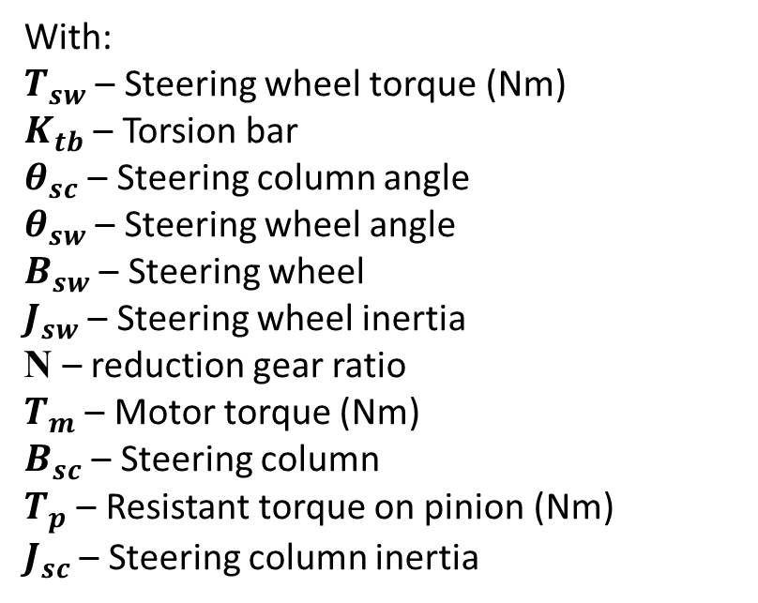
2. THEORETICAL BASIS 2.2. DYNAMIC EQUILIBRIUM EQUATION
$T_{sw}$ - $K_{tb}(θ_{SC}−θ_{SW}$)-$B_{sw}{\dot{θ}}_{sw}$ - $J_{sw}{\ddot{θ}}_{sw}$ + N. $T_{m}$ - $B_{sc}{\dot{θ}}_{sc}$ - $T_{p}$= $J_{sc}{\ddot{θ}}_{sc}$
With:
$T_{sw}$ – Steering wheel torque (Nm)
$K_{tb}$ – Torsion bar
$θ_{sc}$ – Steering column angle
$θ_{sw}$ – Steering wheel angle
$B_{sw}$ – Steering wheel
$J_{sw}$ – Steering wheel inertia
N – reduction gear ratio
$T_{m}$ – Motor torque (Nm)
$B_{sc}$ – Steering column
$T_{p}$ – Resistant torque on pinion (Nm)
$J_{sc}$ – Steering column inertia

Slide 6
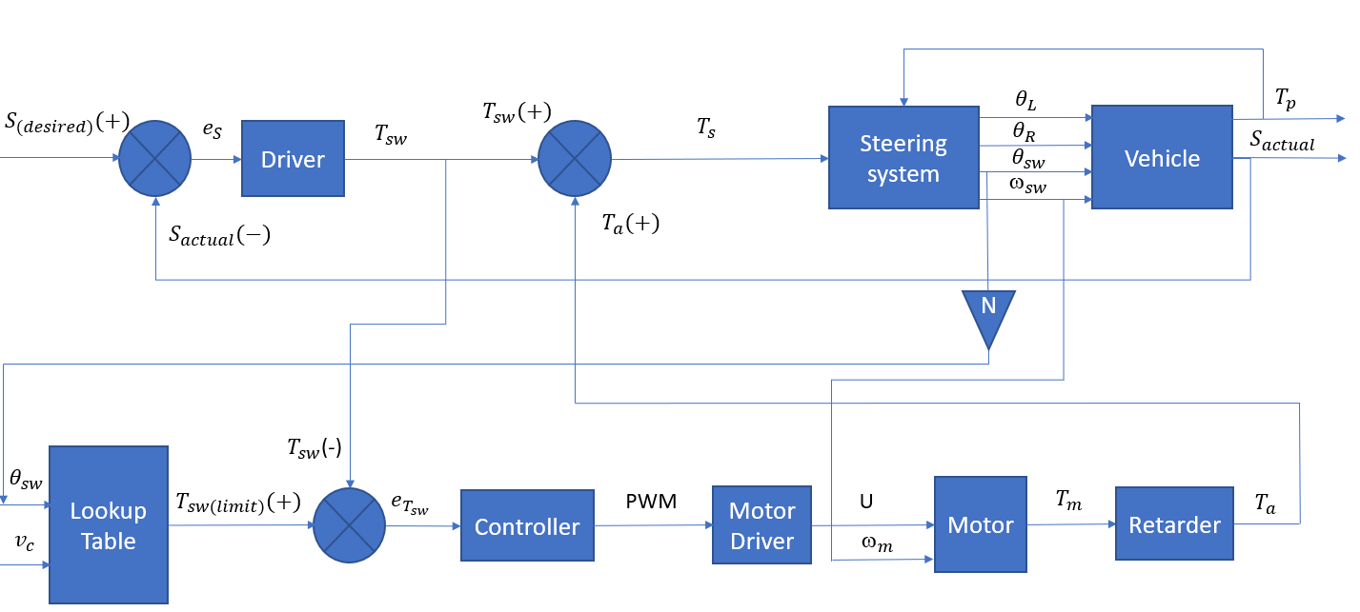
2. THEORETICAL BASIS 2.3. ELECTRIC POWER STEERING (EPS) BLOCK DIAGRAM

Slide 7
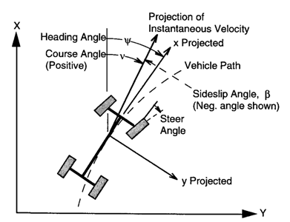
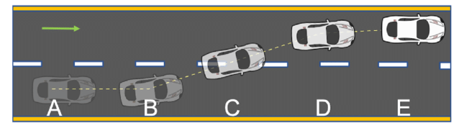
3. SIMULATION PROCESS 3.1 CREATING A PATH

Slide 8
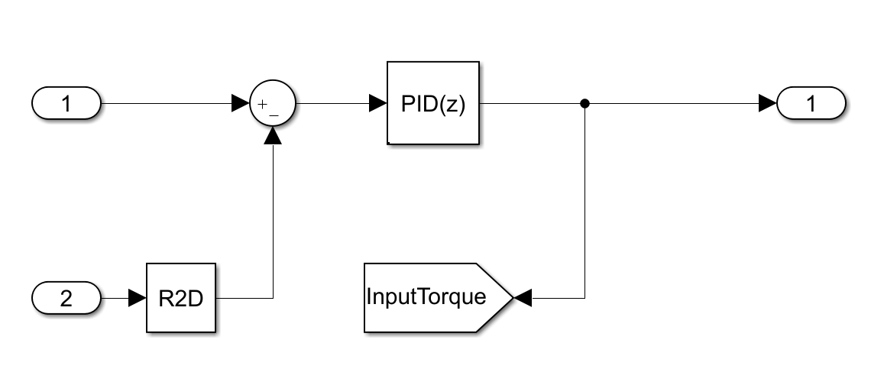
3. SIMULATION PROCESS 3.2 SIMULATION OF A DRIVER

Slide 9
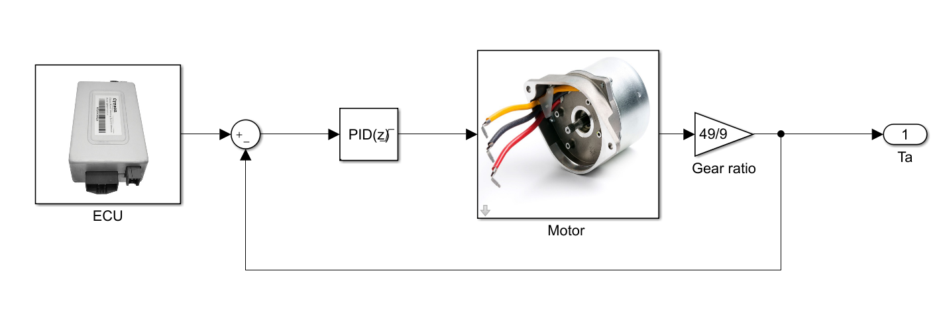
3. SIMULATION PROCESS 3.3. DC MOTOR MODEL

Slide 10
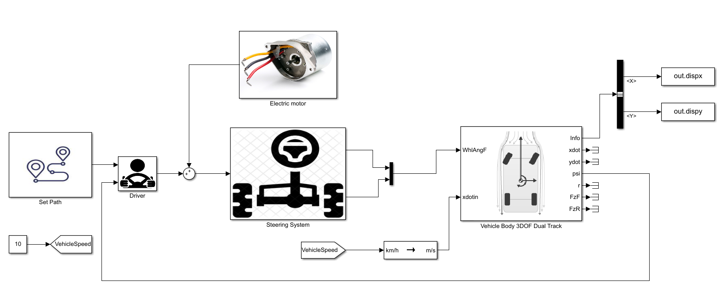
3. SIMULATION PROCESS 3.4. COMPLETE SIMULATION MODEL

Slide 11
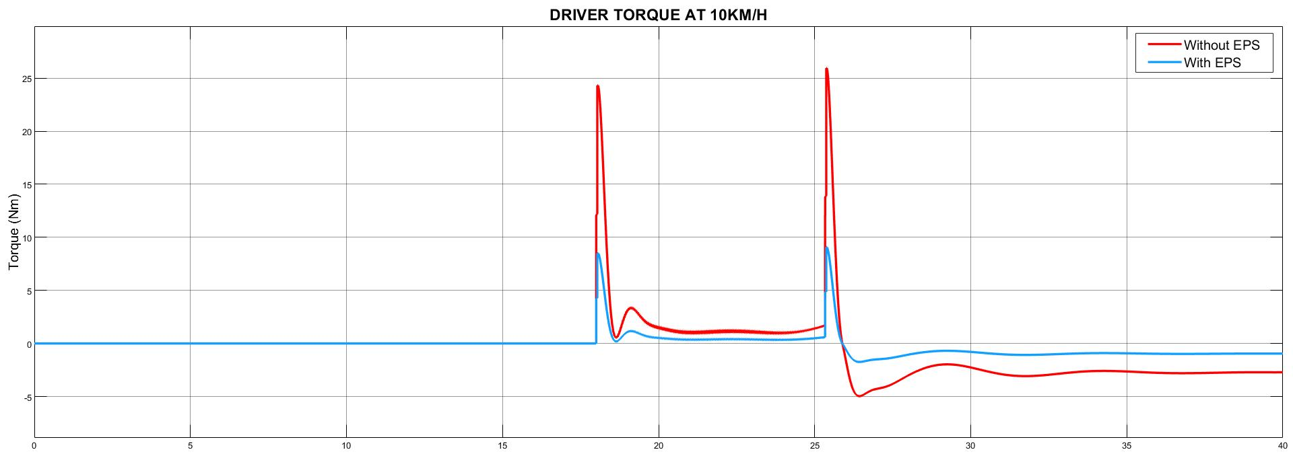
4. RESULT AND EVALUATION 4.1. AT 10KM/H

Slide 12
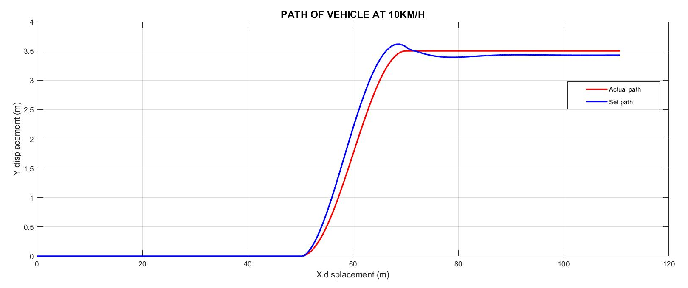
4. RESULT AND EVALUATION 4.1. AT 10KM/H

Slide 13
5. FUTURE WORK AND ENHANCEMENT
PID coefficients need more adjustment
Simulate in more scenarios

